Slide 1
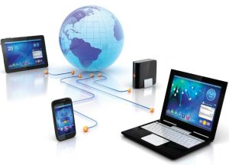
ICT Information and Communication Technologies
Basic Operations and Components of a Generic Computer System
Basic Operations: Input, Processing, Output
Hardware, Software, Data, Users
Storage Basic Components
Types of Storage Devices

Slide 2
Introduction
Computers have become one of the most essential parts of human life!
At present, computers can be seen in almost every sector or field even where it is most unexpected.
Computers can be used in everything from entertainment to communication to navigation to research.
That is why this era is called the era of IT (Information Technology).

Slide 3
…. and NOW….
ONE CANNOT IMAGINE A WORLD WITHOUT COMPUTERS!

Slide 4
Computer
The term ‘computer’ is derived from the Latin word ‘computare’, which is defined as – “to calculate”, “to count” or to “sum up”, etc.
So computer is a device that performs computation.
The first mechanical computer was designed in 1837 by Charles Babbage. It was called “Analytical Engine”. It was the first general-purpose computer. Charles Babbage is known as the father of Computer.

Slide 5
Uses of a Computer
Can store important data
Can communicate with people around the world
Used for educational system
Used for office works like data entry, support, development etc
Used in banking, finance and marketing
Used in government sectors
Used for press and publishing
Used for entertainment

Slide 6
Advantages of Computer
Amazing Speed
Accuracy
Huge Storage
Multitasking support
Data security
Automation
Reduced cost

Slide 7
Disadvantages of Computer
Unemployment
Health issues
Cyber crimes
Virus and hacking attacks
Improper use
Spread of false

Slide 8
What is a Computer?
The literal meaning of computer is a device that can calculate.
However, modern computers can do a lot more than calculate. Computer is an electronic device that receives input, stores or processes the input as per user instructions and provides output in desired format.
A computer is a programmable electronic device designed to accept data, perform prescribed mathematical and logical operations at high speed, and display the results of these operations.
Mainframes, desktop and laptop computers, tablets, and smartphones are some of the different types of computers.

Slide 9
Computer System:
Definition: Is a collection of entities(hardware, software and liveware) that are designed to receive, process, manage and present information in a meaningful format.
COMPONENTS OF COMPUTER SYSTEM Computer hardware - Are physical parts/ intangible parts of a computer. e.g. Input devices, output devices, central processing unit and storage devices
Computer software - also known as programs or applications. They are classified into two classes namely - system software and application software
Liveware - is the computer user. The user commands the computer system to execute on instructions.

Slide 10
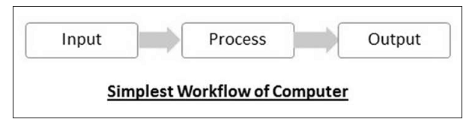
Basic Operations: Input, Processing, Output
Input-Process-Output Model

Slide 11
Basic Operations of a Computer – Input, Process and Output
The computer performs five basic operations which are input, process, output, storage and control and are described as
Input: It is captures the data from user, or it is the process of accepting data or information, by using input the computer can do any process.
Process: It is the process to convert the input into output.
Output: It is the display or output of result from processing.
Storage: It stores the data or information or instructions, for future use.
Control: It directs the manner and sequence of all the operations to perform in a computer system.

Slide 12
Input & Output devices:
Input device: an input device sends information to a computer system for processing
Output device: an output device reproduces or displays the results of that processing.
Input devices only allow for input of data to a computer and output devices only receive the output of data from another device.
Most devices are only input devices or output devices, as they can only accept data input from a user or output data generated by a computer.
However, some devices can accept input and display output, and they are referred to as I/O devices (input/output devices).

Slide 13
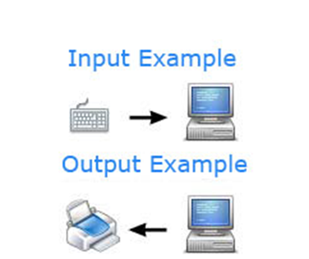
Example:
A keyboard sends electrical signals, which are received as input.
Those signals are then interpreted by the computer and displayed, or output, on the monitor as text or images.
In the lower half of the image, the computer sends, or outputs, data to a printer.
Then, that data is printed onto a piece of paper, which is also considered output.

Slide 14
Input devices
An input device can send data to another device, but it cannot receive data from another device. Examples of input devices include the following.
Keyboard and Mouse - Accepts input from a user and sends that data (input) to the computer. They cannot accept or reproduce information (output) from the computer.
Microphone - Receives sound generated by an input source, and sends that sound to a computer.
Webcam - Receives images generated by whatever it is pointed at (input) and sends those images to a computer.

Slide 15
Output devices
An output device can receive data from another device and generate output with that data, but it cannot send data to another device. Examples of output devices include the following.
Monitor - Receives data from a computer (output) and displays that information as text and images for users to view. It cannot accept data from a user and send that data to another device.
Projector - Receives data from a computer (output) and displays, or projects, that information as text and images onto a surface, like a wall or screen. It cannot accept data from a user and send that data to another device.
Speakers - Receives sound data from a computer and plays the sounds for users to hear. It cannot accept sound generated by users and send that sound to another device.

Slide 16
Input/output devices
An input/output device can receive data from users, or another device (input), and send data to another device (output). Examples of input/output devices include the following.
CD-RW drive and DVD-RW drive - Receives data from a computer (input), to copy onto a writable CD or DVD. Also, the drive sends data contained on a CD or DVD (output) to a computer.
USB flash drive - Receives, or saves, data from a computer (input). Also, the drive sends data to a computer or another device (output).

Slide 17
Data & Information
Computer input is called data and the output obtained after processing it, based on user’s instructions is called information.
Raw facts and figures which can be processed using arithmetic and logical operations to obtain information are called data.

Slide 18
Processes applied on Data:
The processes that can be applied to data are of two types:
Arithmetic operations − Examples include calculations like addition, subtraction, differentials, square root, etc.
Logical operations − Examples include comparison operations like greater than, less than, equal to, opposite, etc.

Slide 19
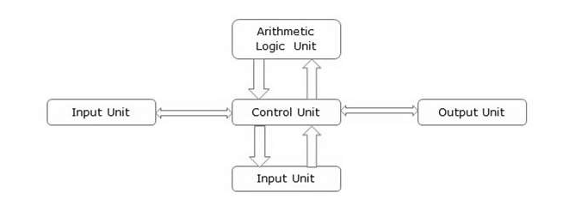
Block Diagram:
The corresponding figure for an actual computer looks something like this −
Block Diagram:

Slide 20
Basic Parts of a Computer:
Input Unit − Devices like keyboard and mouse that are used to input data and instructions to the computer are called input unit.
Output Unit − Devices like printer and visual display unit that are used to provide information to the user in desired format are called output unit.
Control Unit − As the name suggests, this unit controls all the functions of the computer. All devices or parts of computer interact through the control unit.
Arithmetic Logic Unit − This is the brain of the computer where all arithmetic operations and logical operations take place.
Memory − All input data, instructions and data interim to the processes are stored in the memory. Memory is of two types – primary memory and secondary memory. Primary memory resides within the CPU whereas secondary memory is external to it.

Slide 21
Control unit, arithmetic logic unit and memory are together called the central processing unit or CPU.
Computer devices like keyboard, mouse, printer, etc. that we can see and touch are the hardware components of a computer.
The set of instructions or programs that make the computer function using these hardware parts are called software.
We cannot see or touch software. Both hardware and software are necessary for working of a computer.

Slide 22
Characteristics of Computer
To understand why computers are such an important part of our lives, let us look at some of its characteristics −
Speed − Typically, a computer can carry out 3-4 million instructions per second.
Accuracy − Computers exhibit a very high degree of accuracy. Errors that may occur are usually due to inaccurate data, wrong instructions or bug in chips – all human errors.
Reliability − Computers can carry out same type of work repeatedly without throwing up errors due to tiredness or boredom, which are very common among humans.
Versatility − Computers can carry out a wide range of work from data entry and ticket booking to complex mathematical calculations and continuous astronomical observations. If you can input the necessary data with correct instructions, computer will do the processing.
Storage Capacity − Computers can store a very large amount of data at a fraction of cost of traditional storage of files. Also, data is safe from normal wear and tear associated with paper.

Slide 23

Any Questions?

Slide 24
Advantages of using a computer:
The advantages that computers offer−
Computers can do the same task repetitively with same accuracy.
Computers do not get tired or bored.
Computers can take up routine tasks while releasing human resource for more intelligent functions.

Slide 25
Disadvantages of using a Computer:
Despite so many advantages, computers have some disadvantages of their own −
Computers have no intelligence; they follow the instructions blindly without considering the outcome.
Regular electric supply is necessary to make computers work, which could prove difficult everywhere especially in developing nations.

Slide 26
BOOTING:
Starting a computer or a computer-embedded device is called booting. Booting takes place in two steps −
Switching on power supply
Loading operating system into computer’s main memory
Keeping all applications in a state of readiness in case needed by the user

Slide 27
BIOS
The first program or set of instructions that run when the computer is switched on is called BIOS or Basic Input Output System. BIOS is a firmware, i.e. a piece of software permanently programmed into the hardware.
If a system is already running but needs to be restarted, it is called rebooting. Rebooting may be required if a software or hardware has been installed or system is unusually slow.
There are two types of booting −
Cold Booting − When the system is started by switching on the power supply it is called cold booting. The next step in cold booting is loading of BIOS.
Warm Booting − When the system is already running and needs to be restarted or rebooted, it is called warm booting. Warm booting is faster than cold booting because BIOS is not reloaded.

Slide 28
What is Computer Hardware?
Physical structure that houses a computer's processor, memory, storage, communication ports and peripheral devices.
Each of these components (called devices) have a different purpose, which may be either accepting inputs, storing data or sending outputs.
For example:
A mouse and a microphone are input devices used to record user activities and transform them into data that is transmitted to the system unit.
A hard disk is a storage unit where data is stored and accessed by other devices.
A monitor or a speaker are output devices that transform processed data into (respectively) video and audio signals.

Slide 29
Usually, the core components that represent the bare minimum that allow a computer to function are:
Processor (CPU):
The component that processes and executes inputs received from hardware and software.
Motherboard:
A mainboard that provides basic connection between all the other hardware components and devices (internal and external).

Slide 30
3. Memory (RAM):
A temporary data storage space that stores the information the CPU is actively using.
4. Storage device:
A storage device where data is stored on a permanent basis. It’s slower but less volatile than the RAM.
5. Power supply unit:
That’s pretty self-explanatory: without power, no electronic device can work!

Slide 31
What is a Software?
All parts of a computer that are not strictly physical, such as data, programs, applications, protocols, etc., are broadly defined as “software.”
A computer’s operating system (OS) and all its applications are software as well.
A computer works with software programs that are sent to its underlying hardware architecture for reading, interpretation and execution.

Slide 32
Data
Data is a collection of values. Those values can be characters, numbers, or any other data type. If those values are not processed, they have little meaning to a human. Information is data that was processed so a human can read, understand, and use it.
Information informs you of something. It answers a specific question. It represents a specific truth or fact.
Data is the collection of recorded values from which information can be ascertained.
Some data is not relevant or informational. This irrelevant data is called noise.

Slide 33
Example (Data & Information)
The following is an example of raw data, and how that data can be assembled into information.
Example of Data:
UT, 1234, Joe, Circle, SLC, 8015553211, 84084, Smith
In this example, the original data appears to be a set of random words and numbers, separated by commas.
Example of Information:
Joe Smith 1234 Circle Salt Lake City, UT 84084 (801) 555-3211
In this information, the original data was interpreted, organized, and formatted according to predefined parameters. Now the meaning of the data is clear: it is the contact information for a person named Joe Smith.

Slide 34
Users
Computer user:
Alternatively referred to as an end user, a user is any individual who is not involved with supporting or developing a computer or service.
For example, you are the end-user of the computer you are using when you call technical support for help.

Slide 35
Generic types of users
Computer users can be broken up into the following groups based on how experienced the computer user is with a computer:
Advanced user, hardcore user or power user - A user with advanced knowledge about computers software and hardware that require no assistance.
Casual user or regular user - A user who has some computer experience and can navigate and use the computer without much assistance.
Basic user, beginner, novice, or newbie - A user who started using a computer and requires lots of assistance.

Slide 36
Storage Basic Components:
Storage is a process through which digital data is saved within a data storage device by means of computing technology. Storage is a mechanism that enables a computer to retain data, either temporarily or permanently.
Storage devices such as flash drives and hard disks are a fundamental component of most digital devices since they allow users to preserve all kinds of information such as videos, documents, pictures and raw data.
Storage may also be referred to as computer data storage or electronic data storage.

Slide 37
Types of Storage:
Storage is among the key components of a computer system and can be classified into several forms, although there are two major types:
Volatile Storage (Memory): Requires a continuous supply of electricity to store/retain data. It acts as a computer's primary storage for temporarily storing data and handling application workloads. Examples of non-volatile storage include cache memory and random access memory (RAM).
Non-Volatile Storage: A type of storage mechanism that retains digital data even if it’s powered off or isn’t supplied with electrical power. This is often referred to as a secondary storage mechanism, and is used for permanent data storage requiring I/O operations. Examples of volatile storage include a hard disk, USB storage and optical media.

Slide 38
Storage is often confused for memory, although in computing the two terms have different meanings. Memory refers to short-term location of temporary data (see volatile storage above), while storage devices, in fact, store data on a long-term basis for later uses and access. While memory is cleared every time a computer is turned off, stored data is saved and stays intact until it’s manually deleted. Primary or volatile storage tends to me much faster than secondary storage due to its proximity to the processor, but it’s also comparably smaller. Secondary storage can hold and handle significantly larger sizes of data, and keeps it inactive until it’s needed again.

Slide 39
Types of Storage Devices:
Primary storage, which is also referred to as internal memory, is accessed by a computer's central processing unit (CPU).
It is usually the fastest and most expensive type of memory in the computer.
Primary storage uses random-access memory (RAM), cache memory, or some other specialized hardware to store data while the computer is powered on.
When power is removed, RAM is wiped clean.
The volatile nature of RAM means that additional storage devices are needed that continue to work when a computer is powered off.

Slide 40
Secondary storage on a computer is provided by non-volatile devices such as hard disk drives.
Even though a hard drive may be housed within a desktop or laptop, it's not considered to be primary because it's not accessed directly by the CPU.
Data stored on hard disk drives and most other types of secondary storage devices is organized according to a file system.
This type of storage is slower than primary storage, but it's also cheaper.

Slide 41
Tertiary storage is a third type of storage not typically found on a personal computer.
This kind of storage device consists of high-capacity archives designed to house massive amounts of data on mountable media such as optical discs.
The device typically includes a robotic arm or another mechanism that locates media containing specific data and transfers it from a storage location to a drive where the contained data can be accessed.

Slide 42
Storage Devices Examples
The average personal computer user mainly comes into contact with secondary computer storage devices.
These include an internal hard drive and external drives that are typically connected via a standard interface like a USB cable.
In the past, many computers came equipped with a drive to read and write CDs and DVDs.
Today, this type of disc drive is more often connected as an external device, along with Blue-ray disc drives.

Slide 43
Examples of Storage Devices
Common storage devices that are in use or have been used in the past include:
Hard disks.
Flash drives.
Floppy diskettes.
Tape drives.
CD-ROM disks.
Blu-ray disks.
Memory cards.
Cloud drives.

Slide 44
After a software command is issued by the user, digital data is stored inside the appropriate device. Data size is measured in bits (the smallest unit of measure of computer memory), with larger storage devices being able to store more data.
Storage capabilities have increased significantly in the last few decades, jumping up from the old 5.25-inch disks of the 1980s which held 360 kilobytes, to the modern hard drives which can hold several terabytes.

Slide 45
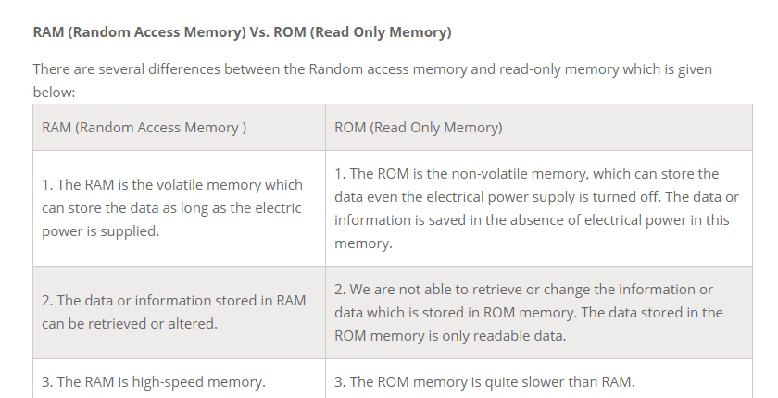

Slide 46
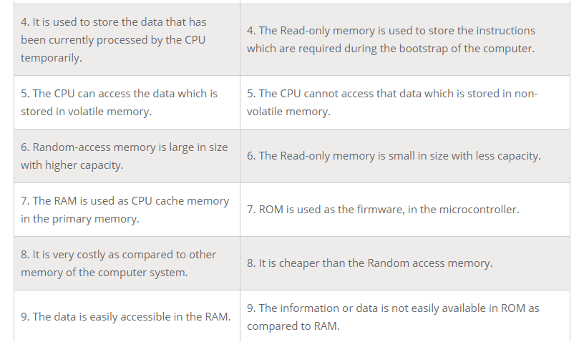

Slide 47
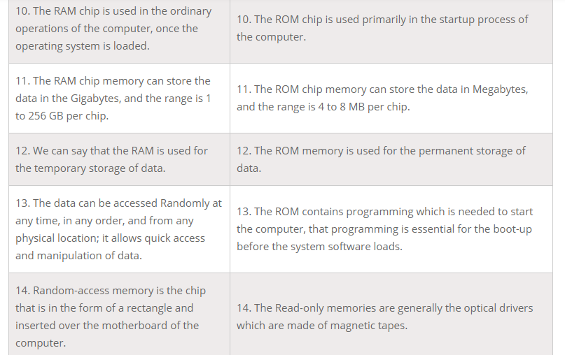

Slide 48
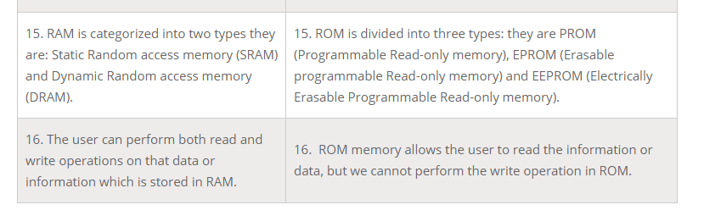

Slide 49
Difference between Internet and www
Internet
The Internet is a global connection of various networks. It allows communication between any two computers on the planet. Everything we do day-to-day, such as e-mail, surfing, and video chat is facilitated by the Internet, but only where data is exchanged.
World Wide Web
The World Wide Web is a visual medium over which information is accessed. It is built on top of the Internet. The World Wide Web utilizes web browsers to display the information it receives from the Internet.

